Slide 1
ALGORITHMS
演算法
Chapter 1
Algorithms: Efficiency, Analysis, and Order

Slide 2
Algorithms (1/2)
Problem
  design of the individual modules that accomplish the specific tasks
  Determine whether the number x is in the list S of n numbers. The answer is “yes” if x is in S and “no” if it is not.
parameter
  A “problem” may contain variables that are not assigned specific values in the statement of the problem.
  S、n、x
instance: each specific assignment of values to the parameters
  S = [10, 7, 11, 5, 13, 8], n = 6, x = 5
solution: the answer to the question asked by the problem in that instance
  yes

Slide 3
Algorithms (2/2)
Algorithms
  specify a general step-by-step procedure for producing the solution to each instance
  algorithm solves the problem
Determine whether the number x is in the list S of n numbers. The answer is “yes” if x is in S and “no” if it is not.
  Starting with the first item in S, compare x with each item in S in sequence until x is found or until S is exhausted. If x is found, answer yes; if x is not found, answer no.
  Input: number n, list S with n elements, key number x。
  Output: yes or no
  Finiteness: until x is found or until S is exhausted
  Definiteness
  Correctness

Slide 4
Sequential Search
Algorithm 1.1
  Problem: Is the key x in the array S of n keys?
  Input: positive integer n, array of keys S indexed from 1 to n, and a key x.
  Output: location, the location of x in S (0 if x is not in S)
  also called linear search
search 10
18 | 3 | 9 | 15 | 10 | 5 | 6 | 11
search 12

Slide 5

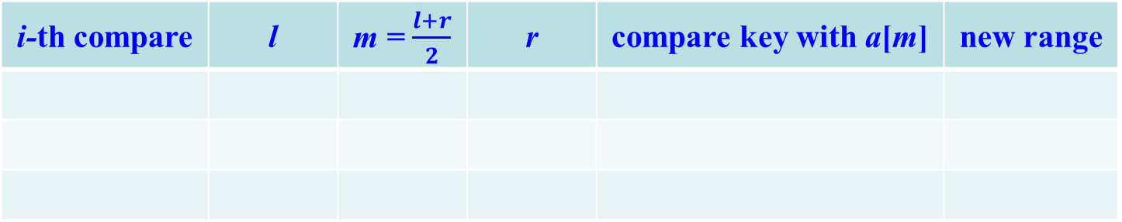


Binary Search
array is sorted in nondecreasing order, binary search is more efficient
compare key x with the middle item (a[m])of the array:
  key = a[m]：algorithm done
  key < a[m]：key x must be in the first half of the array (a[l] ~ a[m – 1])
  key > a[m]：key x must be in the second half of the array (a[m + 1] ~ a[r])
  key = 78
[0]
[1]
[2]
[3]
[4]
[5]
[6]
[7]
[8]
[9]
6 | 33 | 39 | 41 | 52 | 55 | 69 | 77 | 78 | 81
i-th compare | l | m = $\frac{l+r}{2}$ | r | compare key with a[m] | new range
1
0
$$\frac{0+9}{2}=4$$
9
78 > a[4] = 52
右
2
5
$$\frac{5+9}{2}=7$$
9
78 > a[7] = 77
右
3
8
$$\frac{8+9}{2}=8$$
9
78 = a[8] = 78
成功

Slide 6
Number of Comparisons
If the array S contains 32 items and x is not in the array.
  sequential search: 32 times
  binary search: 6 times (lg 32 + 1)
If the array S contains 32 items and x is in the array.
  sequential search: no more than 32 times
  binary search: no more than 6 times (lg 32 + 1)
Array Size | Number of Comparisons by Sequential Search | Number of Comparisons by Binary Search
128 | 128 | 8
1,024 | 1,024 | 11
1,048,576 | 1,048,576 | 21
4,294,967,296 | 4,294,967,296 | 33

Slide 7
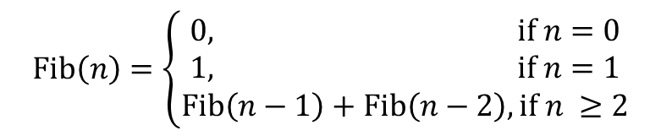
The Fibonacci Sequence (1/4)
0, 1, 1, 2, 3, 5, 8, 13, 21, 34,…
compute the nth term of the Fibonacci sequence
$$\text{Fib}\left(n\right)=\left\{\begin{aligned}0, \text{if} n=0 \\ 1, \text{if} n=1 \\ \text{Fib}\left(n−1\right)+\text{Fib}\left(n−2\right), \text{if} n ≥2\end{aligned}\right.$$
5
F(5)
3
2
n | Number of Terms Computed
0 | 1
1 | 1
2 | 3
3 | 5
4 | 9
5 | 15
6 | 25
F(4)
F(3)
2
1
1
1
F(3)
F(2)
F(2)
F(1)
1
1
1
0
1
0
F(2)
F(1)
F(1)
F(0)
F(1)
F(0)
1
0
F(1)
F(0)

Slide 8
The Fibonacci Sequence (2/4)
Theorem 1.1: If T(n) is the number of terms in the recursion tree corresponding to Algorithm 1.6, then, for n ≥ 2, T(n) > 2^{n/2}.
T(n) = T(n – 1) + T(n – 2)
> 2 × T(n – 2)
> 2 × 2 × T(n – 4)
> 2 × 2 × 2 × T(n – 6)
…
> 2 × 2 × 2 × 2 × … × 2 × T(0)
n/2 terms

Slide 9
The Fibonacci Sequence (3/4)
Theorem 1.1: If T(n) is the number of terms in the recursion tree corresponding to Algorithm 1.6, then, for n ≥ 2, T(n) > 2^{n/2}.
Proof. By induction on n
  induction base: n = 2, n = 3
    T(2) = 3 > 2^{2/2}
    T(3) = 5 > 2^{3/2} ≈ 2.8323
  induction hypothesis:
    for all m, 2 ≤ m < n, T(m) > 2^{m/2}
  induction step:
    T(n) = T(n – 1) + T(n – 2) + 1
    > 2^{(n–1)/2} + 2^{(n–2)/2} + 1
    > 2^{(n–2)/2} + 2^{(n–2)/2}
    > 2 × 2^{(n/2)–1}
    = 2^{(n/2)}
inefficient

Slide 10
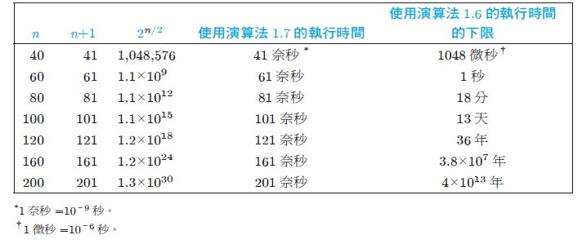
The Fibonacci Sequence (4/4)
It is inefficient for computing nth Fibonacci by using recursive algorithm
  the same value is computed over and over
When computing a value, we save it in an array.
[0]
[1]
[2]
[3]
[4]
[5]
[6]
[7]
[8]
[…]
0 | 1 | 1 | 2 | 3 | 5 | 8 | 13 | 21 | …

Slide 11
Binary Search (Algorithm 1.5) and nth Fibonacci Term (Algorithm 1.6)
  divide-and-conquer
  Chapter 2
nth Fibonacci Term (iterative) (Algorithm 1.7)
  dynamic programming
  Chapter 3

Slide 12
Analysis of Algorithms
The running time of an algorithm increases with the size of input, and the total running time is roughly proportional to how many times some basic operation (such as a comparison instruction)
  analyze the algorithm’s efficiency by determining the number of times some basic operation is done as a function of the size of the input
basic operation
  pick some instruction or group of instructions such that the total work done by the algorithm is roughly proportional to the number of times this instruction or group of instructions is done
  Algorithms 1.1 and 1.5:
    basic operation is the compare instruction

Slide 13
Time Complexity (1/3)
determining how many times the basic operation is done for each value of the input size
Sequential Search (Algorithm 1.1): the number of times it is done depends not only on the input size, but also on the input’s values
  key x is the first item in the array: done once
  key x is not in the array: done n times
Add Array Members (Algorithm 1.2): done the same number of times for every instance of size n
  T(n): the number of times the algorithm does the basic operation for an instance of size n (every-case time complexity)
  basic operation: the addition of an item in the array to sum
  input size: the number of items in the array, n
  Regardless of the values of the numbers in the array, there are n passes through the for loop.
  The basic operation is always done n times: T(n) = n
best
worst

Slide 14
Time Complexity (2/3)
for an input size of n, three analysis techniques:
  worst-case time complexity W(n): the maximum number times
  average-case time complexity A(n): the average of number of times
  best-case time complexity B(n): the minimum number times
Sequential Search:
  basic operation: the comparison of an item in the array with x
  Input size: the number of items in the array, n
  worst case: x is the last item in the array or x is not in the array
    W(n) = n
  best case: x = S[1], one pass through the loop regardless of the size of n
    B(n) = 1

Slide 15
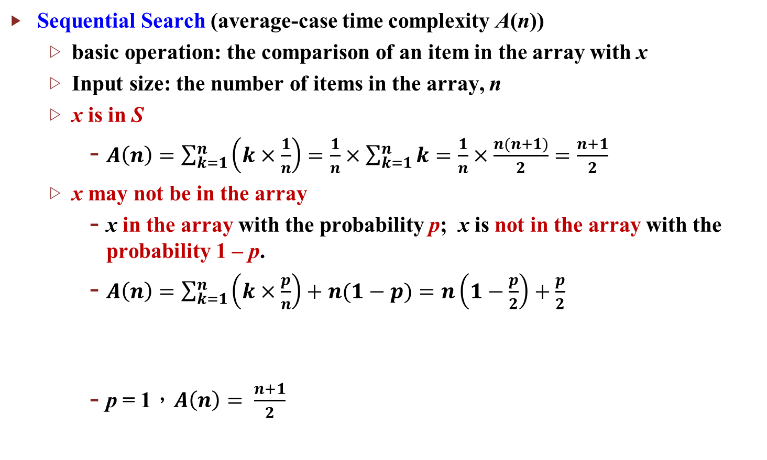
Time Complexity (3/3)
Sequential Search (average-case time complexity A(n))
  basic operation: the comparison of an item in the array with x
  Input size: the number of items in the array, n
  x is in S
    $A\left(n\right)=\sum_{k=1}^{n}{\left(k×\frac{1}{n}\right)=\frac{1}{n}×\sum_{k=1}^{n}{k}=\frac{1}{n}×\frac{n(n+1)}{2}=\frac{n+1}{2}}$
  x may not be in the array
    x in the array with the probability p; x is not in the array with the probability 1 – p.
    $A\left(n\right)=\sum_{k=1}^{n}{\left(k×\frac{p}{n}\right)+n(1−p)}=n\left(1−\frac{p}{2}\right)+\frac{p}{2}$
    p = 1，$A\left(n\right)= \frac{n+1}{2}$
in the array
not in the array

Slide 16
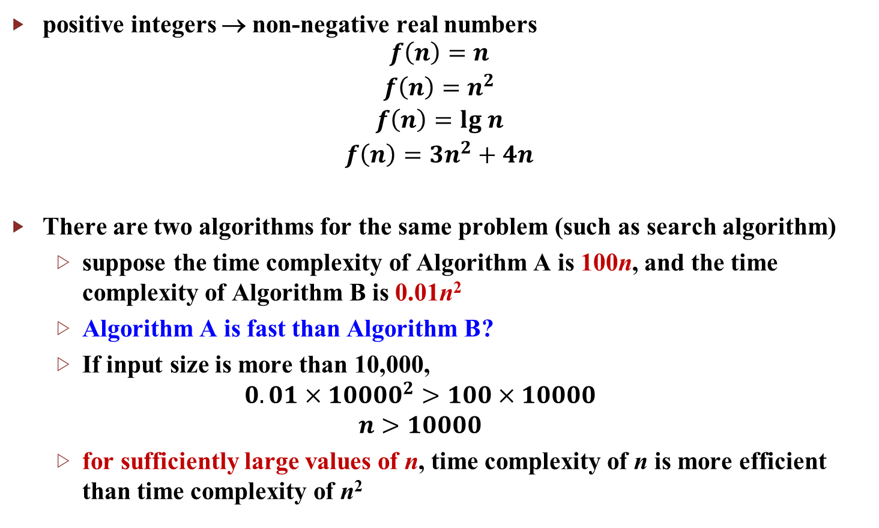
Complexity Function (1/3)
positive integers → non-negative real numbers
$$\begin{matrix}f\left(n\right)=n \\ f\left(n\right)=n^{2} \\ f\left(n\right)=lg n \\ f\left(n\right)=3n^{2}+4n\end{matrix}$$
There are two algorithms for the same problem (such as search algorithm)
  suppose the time complexity of Algorithm A is 100n, and the time complexity of Algorithm B is 0.01n²
  Algorithm A is fast than Algorithm B?
  If input size is more than 10,000,
  $$0.01×{10000}^{2}>100×10000$$
  $$n>10000$$
  for sufficiently large values of n, time complexity of n is more efficient than time complexity of n²

Slide 17
Complexity Function (2/3)
pure quadratic function: contain no linear term
  5n²、5n² + 100
complete quadratic function:
  0.1n² + n + 100
throw away low-order terms when classifying complexity functions
  classify 0.1n³ + 10n² + 5n + 25 with pure cubic function
n | 0.1n² | 0.1n² + n + 100
10 | 10 | 120
20 | 40 | 160
50 | 250 | 400
100 | 1000 | 1200
1000 | 100000 | 101100

Slide 18
Complexity Function (3/3)
Θ(n²): the set of all complexity functions that can be classified with pure quadratic functions
  g(n) = 5n² + 100n + 20 ∈ Θ(n²)
  When an algorithm’s time complexity is in Θ(n²), the algorithm is called a quadratic-time algorithm or a Θ(n²) algorithm.
the most common complexity categories:
Θ(lg n) Θ(n) Θ(nlg n) Θ(n²) Θ(n³) Θ(2^{n})
An algorithm has to be Θ(nlg n) or better for us to assume that it can process extremely large instances in tolerable amounts of time.

Slide 19
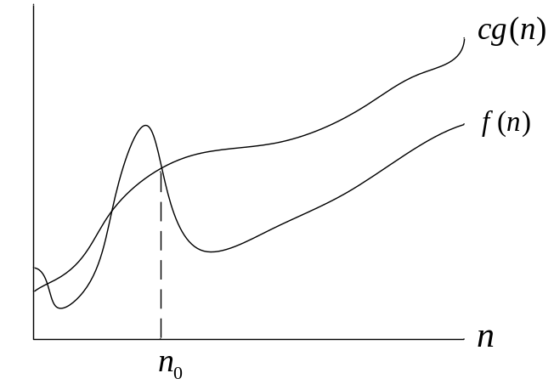
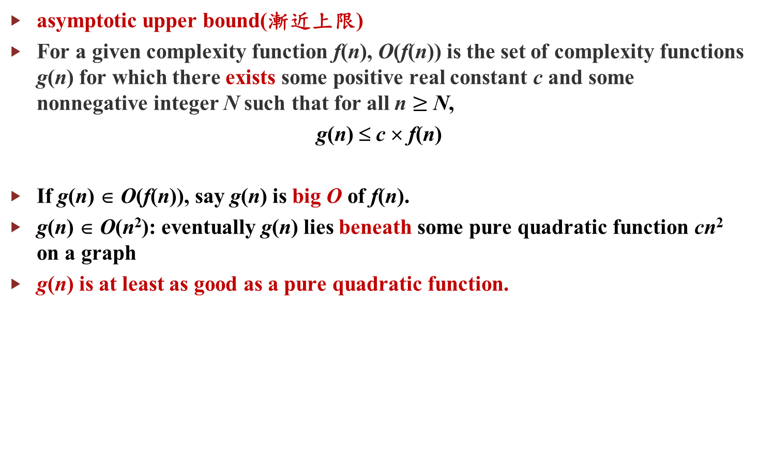
big O (1/2)
asymptotic upper bound(漸近上限)
For a given complexity function f(n), O(f(n)) is the set of complexity functions g(n) for which there exists some positive real constant c and some nonnegative integer N such that for all n $≥$ N,
g(n) ≤ c × f(n)
If g(n) ∈ O(f(n)), say g(n) is big O of f(n).
g(n) ∈ O(n²): eventually g(n) lies beneath some pure quadratic function cn² on a graph
g(n) is at least as good as a pure quadratic function.
cf(n)
g(n)
N

Slide 20
big O (2/2)
For a given complexity function f(n), O(f(n)) is the set of complexity functions g(n) for which there exists some positive real constant c and some nonnegative integer N such that for all n ≥ N,
g(n) ≤ c × f(n)
Show that 5n² ∈ O(n²).
  g(n) = 5n², f(n) = n²
  take c = 5 and N = 0
  5n² ≤ 5 × n², for all n ≥ 0
Show that n² + 10n ∈ O(n²).
  g(n) = n² + 10n, f(n) = n²
  take c = 2 and N = 10
  n² + 10n ≤ 2 × n², for all n ≥ 10
  g(n) = n² + 10n, f(n) = n²
  take c = 11 and N = 1
  n² + 10n ≤ n² + 10n² = 11 × n², for all n ≥ 1
big O: upper bound

Slide 21
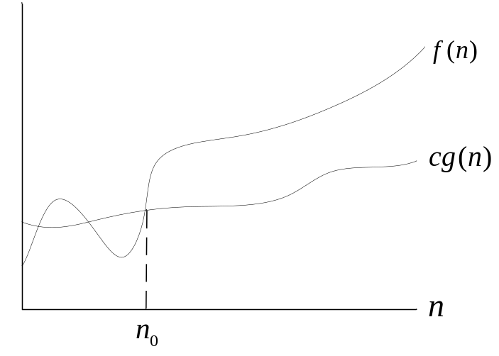
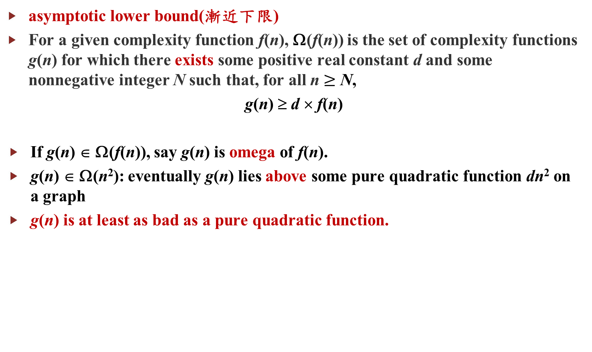
omega Ω (1/2)
asymptotic lower bound(漸近下限)
For a given complexity function f(n), Ω(f(n)) is the set of complexity functions g(n) for which there exists some positive real constant d and some nonnegative integer N such that, for all n $≥$ N,
g(n) ≥ d × f(n)
If g(n) ∈ Ω(f(n)), say g(n) is omega of f(n).
g(n) ∈ Ω(n²): eventually g(n) lies above some pure quadratic function dn² on a graph
g(n) is at least as bad as a pure quadratic function.
g(n)
df(n)
N

Slide 22
omega Ω (2/2)
For a given complexity function f(n), Ω(f(n)) is the set of complexity functions g(n) for which there exists some positive real constant c and some nonnegative integer N such that, for all n ≥ N,
g(n) ≥ d × f(n)
Show that 5n² ∈ Ω(n²).
  g(n) = 5n², f(n) = n²
  take d = 1 and N = 0
  5n² ≥ 1 × n², for n ≥ 0
Show that n² + 10n ∈ Ω(n²).
  g(n) = n² + 10n, f(n) = n²
  take d = 1 and N = 0
  n² + 10n ≥ 1 × n², for n ≥ 0
Ω: lower bound

Slide 23
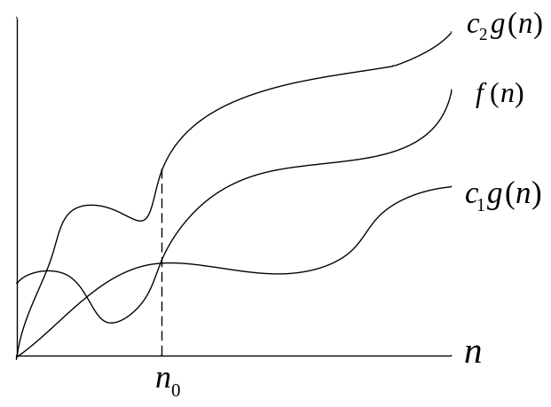
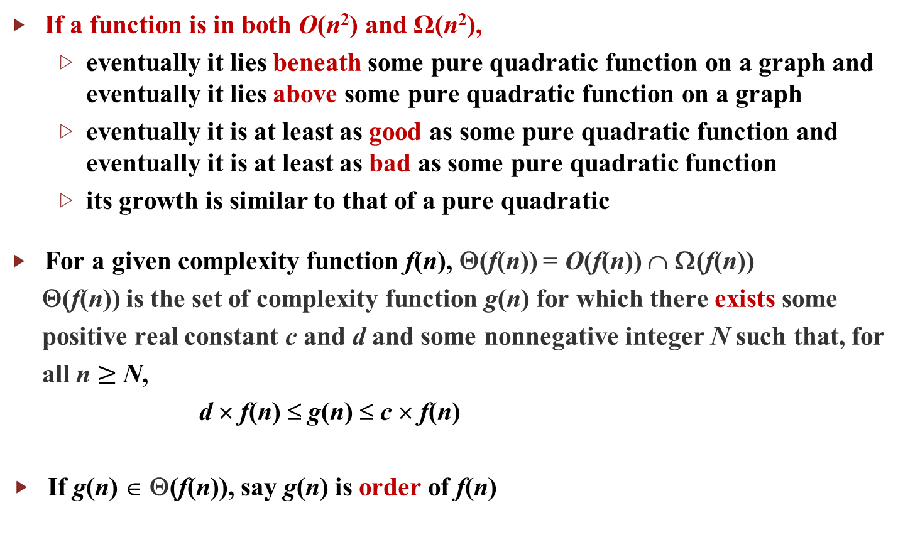
theta Θ (1/3)
If a function is in both O(n²) and Ω(n²),
  eventually it lies beneath some pure quadratic function on a graph and eventually it lies above some pure quadratic function on a graph
  eventually it is at least as good as some pure quadratic function and eventually it is at least as bad as some pure quadratic function
  its growth is similar to that of a pure quadratic
For a given complexity function f(n), Θ(f(n)) = O(f(n)) ∩ Ω(f(n))
Θ(f(n)) is the set of complexity function g(n) for which there exists some
positive real constant c and d and some nonnegative integer N such that, for
all n $≥$ N,
d × f(n) ≤ g(n) ≤ c × f(n)
If g(n) ∈ Θ(f(n)), say g(n) is order of f(n)
cf(n)
g(n)
df(n)
N

Slide 24
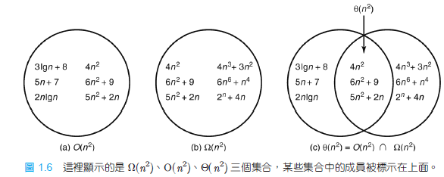
theta Θ (2/3)
beneath cn²
above cn²

Slide 25
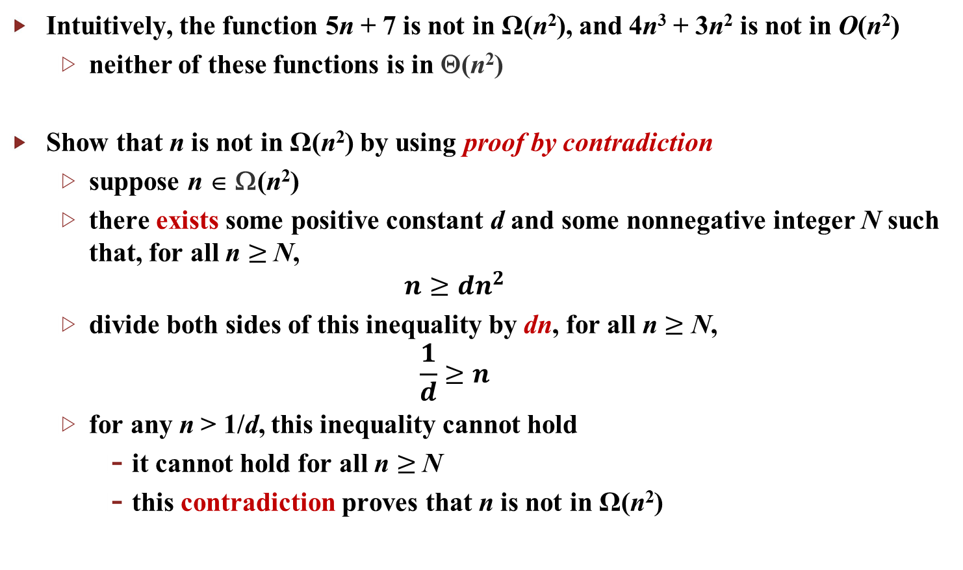
theta Θ (3/3)
Intuitively, the function 5n + 7 is not in Ω(n²), and 4n³ + 3n² is not in O(n²)
  neither of these functions is in Θ(n²)
Show that n is not in Ω(n²) by using proof by contradiction
  suppose n ∈ Ω(n²)
  there exists some positive constant d and some nonnegative integer N such that, for all n $≥$N,
  $$n≥dn^{2}$$
  divide both sides of this inequality by dn, for all n $≥$ N,
  $$\frac{1}{d}≥n$$
  for any n > 1/d, this inequality cannot hold
    it cannot hold for all n $≥$N
    this contradiction proves that n is not in Ω(n²)
定義

Slide 26
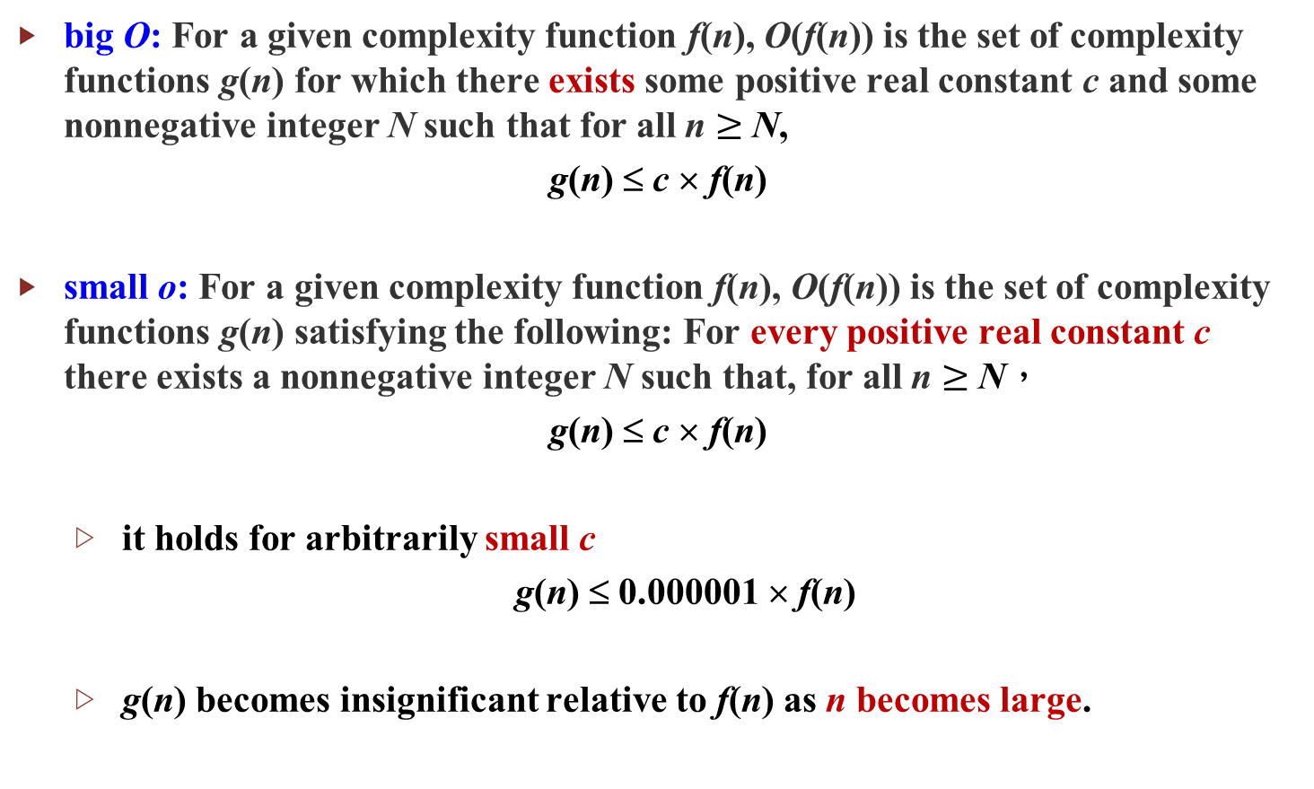
small o (1/3)
big O: For a given complexity function f(n), O(f(n)) is the set of complexity functions g(n) for which there exists some positive real constant c and some nonnegative integer N such that for all n $≥$ N,
g(n) ≤ c × f(n)
small o: For a given complexity function f(n), O(f(n)) is the set of complexity functions g(n) satisfying the following: For every positive real constant c there exists a nonnegative integer N such that, for all n $≥$ N，
g(n) ≤ c × f(n)
  it holds for arbitrarily small c
  g(n) ≤ 0.000001 × f(n)
  g(n) becomes insignificant relative to f(n) as n becomes large.

Slide 27
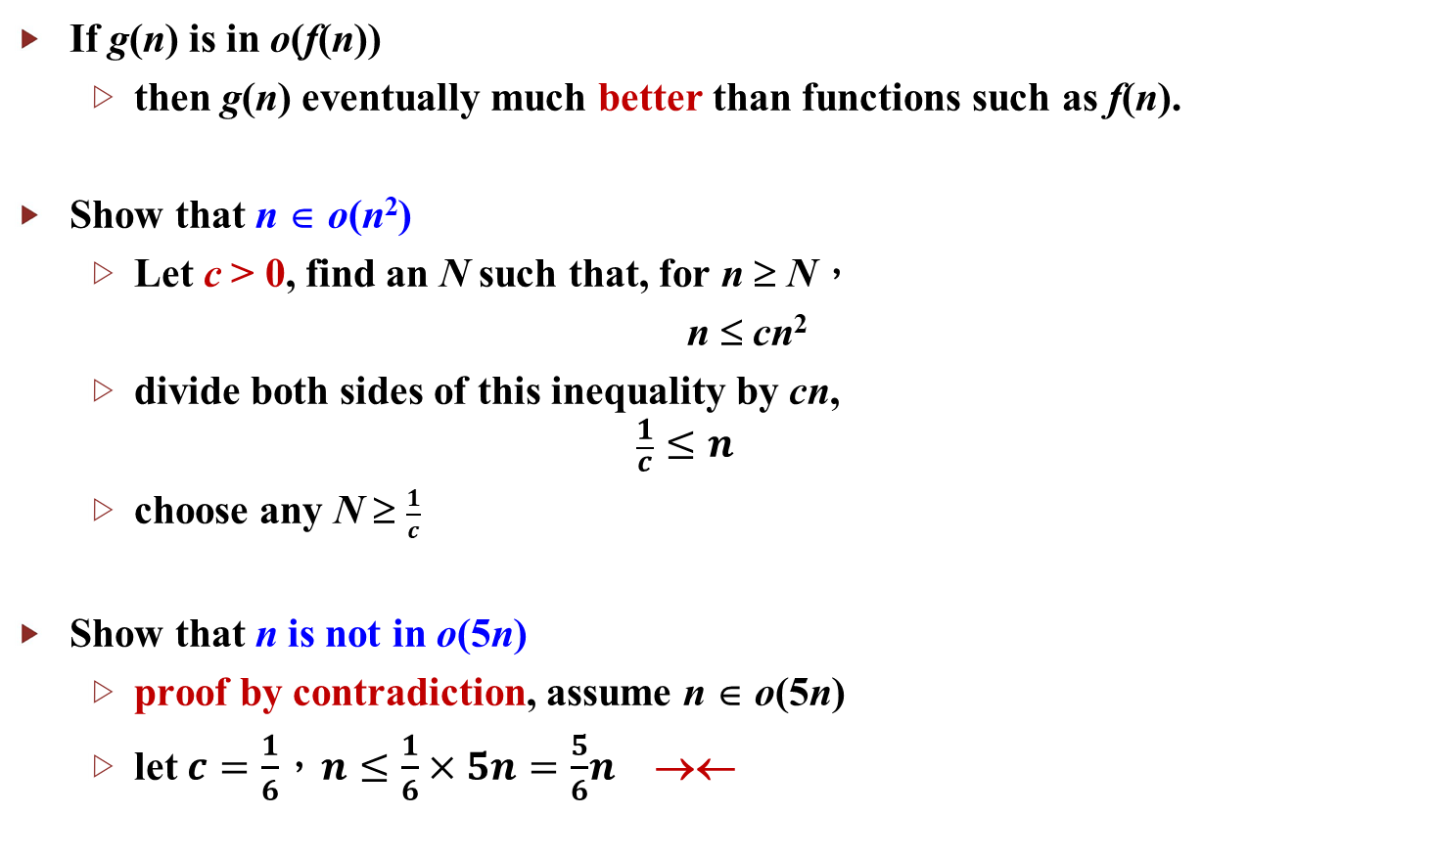
small o (2/3)
If g(n) is in o(f(n))
  then g(n) eventually much better than functions such as f(n).
Show that n ∈ o(n²)
  Let c > 0, find an N such that, for n ≥ N，
  n ≤ cn²
  divide both sides of this inequality by cn,
  $$\frac{1}{c}≤n$$
  choose any N ≥ $\frac{1}{c}$
Show that n is not in o(5n)
  proof by contradiction, assume n ∈ o(5n)
  let $c=\frac{1}{6}$，$n≤\frac{1}{6}×5n=\frac{5}{6}n$ →←

Slide 28
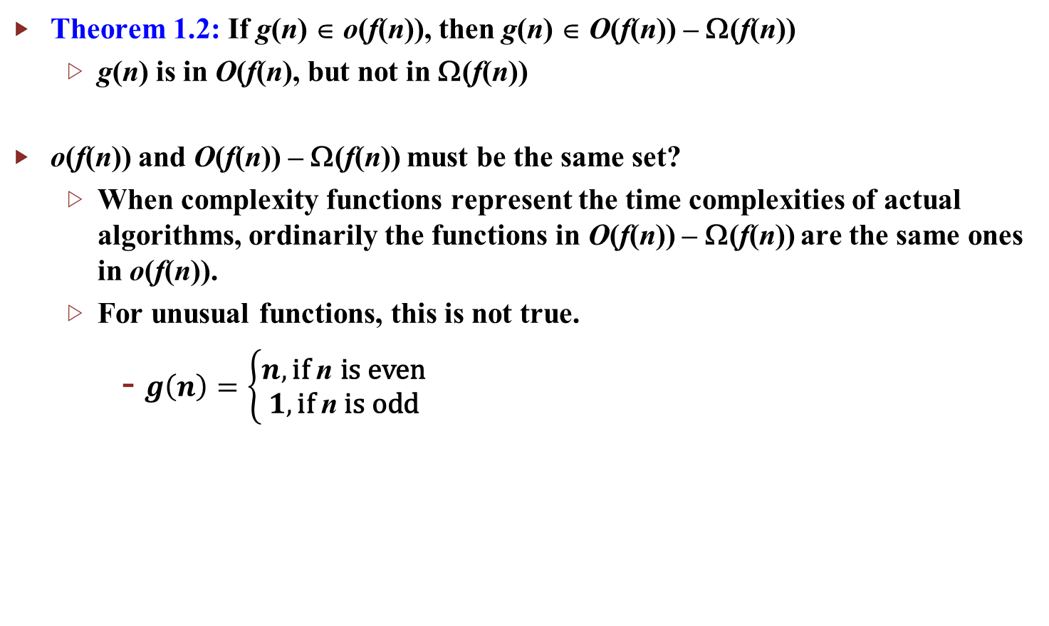
small o (3/3)
Theorem 1.2: If g(n) ∈ o(f(n)), then g(n) ∈ O(f(n)) – Ω(f(n))
  g(n) is in O(f(n), but not in Ω(f(n))
o(f(n)) and O(f(n)) – Ω(f(n)) must be the same set?
  When complexity functions represent the time complexities of actual algorithms, ordinarily the functions in O(f(n)) – Ω(f(n)) are the same ones in o(f(n)).
  For unusual functions, this is not true.
    $g\left(n\right)=\left\{\begin{matrix}n, \text{if} \text{n} \text{is} \text{even} \\ 1, \text{if} \text{n} \text{is} \text{odd}\end{matrix}\right.$

Slide 29
Properties of Order (1/2)
g(n) ∈ O(f(n)) iff f(n) ∈ Ω(g(n))
g(n) ∈ Θ(f(n)) iff f(n) ∈ Θ(g(n))
If a > 1 and b > 1, then log_{a}n ∈ Θ(log_{b}n)
  all logarithmic complexity functions are in the same complexity category: Θ(lg n)
If b > a > 0, then a^{n} ∈ o(b^{n})
  all exponential complexity functions are not in the same complexity category
For all a > 0, a^{n} ∈ o(n!)
  n! is worse than any exponential complexity function
Θ(lg n), Θ(n), Θ(nlg n), Θ(n²), Θ(n^{j}), Θ(n^{k}), Θ(a^{n}), Θ(b^{n}), Θ(n!), where k > j > 2，b > a > 1
  g(n) ∈ o(f(n))
  logarithmic functions are better than polynomial; polynomial is better than exponential; exponential is better than factorial

Slide 30
Properties of Order (2/2)
If c ≥ 0，d > 0, g(n) ∈ O(f(n)), and h(n) ∈ Θ(f(n)), then
  c × g(n) + d × h(n) ∈ Θ(f(n))
  throw out low-order terms
If we are unable to determine T(n) exactly,
  show that T(n) ∈ O(f(n)) and T(n) ∈ Ω(f(n))
  by appealing directly to the definitions, conclude T(n) ∈ Θ(f(n))
Sometimes, easily to show that T(n) ∈ O(f(n)), but difficult to determine T(n) ∈ Ω(f(n))
  show only T(n) ∈ O(f(n))
  imply that T(n) is at least as bad as functions such as f(n)

